Slide 1

Test Plan / Test Scripts
Team 5: Vanilla Systems
Presenter: Jesse Yanez Garcia
IT-493-DL1
Date: 3/19/2023
George Mason University

Slide 2

Introduction
Great Oak Cleaning Solutions has contracted Vanilla Systems, to develop, design and test a new web application that will replace their current system. Vanilla Systems’ focus is in ensuring a functional and readily accessible web application that meets our client’s expectations. We will conduct manual testing instead of automation due to the limited scope of the project.

Slide 3

Scope & Objectives
Scope
This test plan focuses on the functionality of the web application across different hardware. Vanilla System’s target for testing is to meet requirement specifications appointed to us by our client.
Test Objectives
Responsiveness
The Quality of Content
Ease of use
The Reliability
Functionality Testing
Website traffic will not be tested due to limited resources.

Slide 4
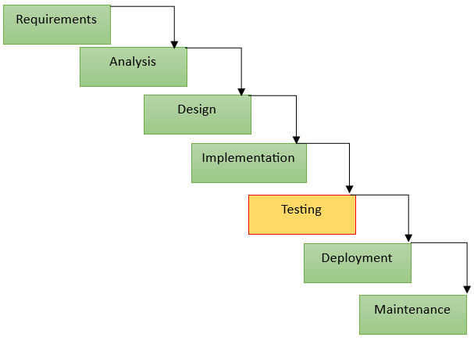
Waterfall Testing Methodology
Waterfall Model
Waterfall Model - A sequential approach to the software development lifecycle (SDLC). Goals have to be met to continue into the next phase of development.
Waterfall Testing - Testing is done as a separate phase. Testing is done after the completion of the development phase.

Slide 5
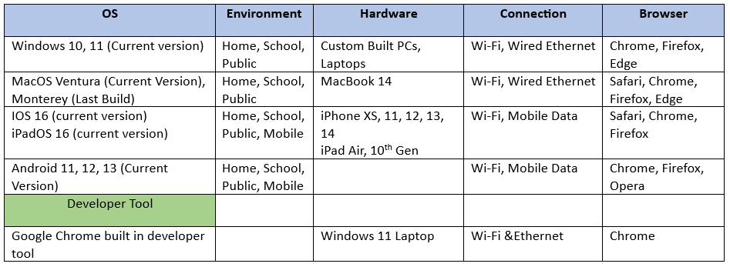
Testing Environment
Linux (Ubuntu)
Samsung, Lenovo, Google

Slide 6

Testing Environment Cont.
Environment Choices
We want to conduct our testing in various environments that will imitate that customer’s experience. We will replicate different scenarios in real world application to test the functionality across multiple device and connections.
Advantages
Hardware is readily available
Testing can be done at any time
Manual Testing
Immediate Action
Disadvantages
Limited hardware
Time Constraints
No Customer Feedback

Slide 7
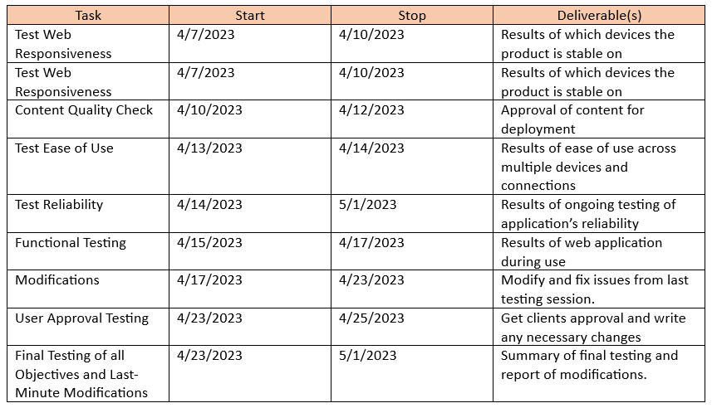
Test Schedule
Alpha Testing Period
Beta Testing Period

Slide 8
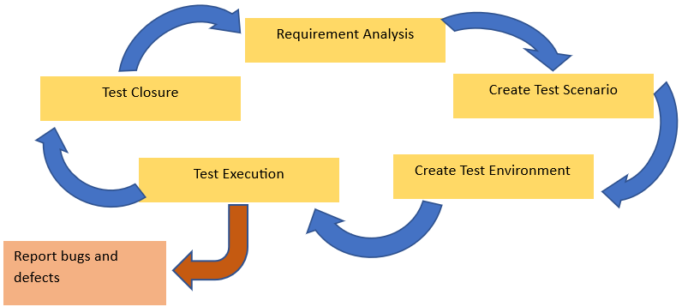
Test Cycle
Test execution phase is dependent of create test environment phase. Reporting bugs and defects is part of test execution phase.

Slide 9
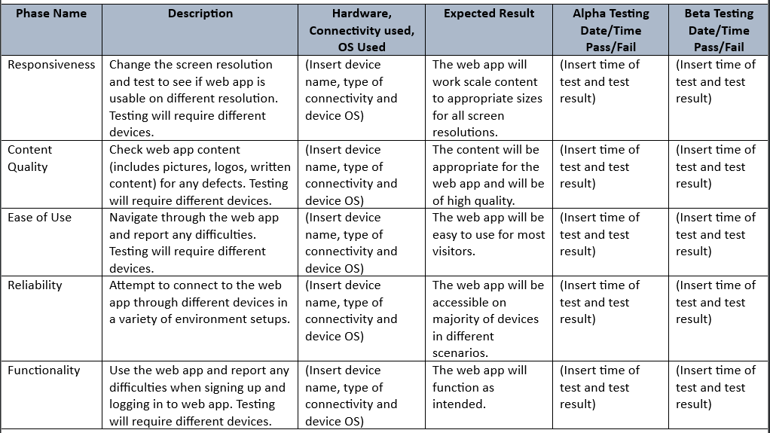
Test Scripts

Slide 10

Monitoring and Controlling the Testing Schedule
Creating a Google calendar and share it among teammates.
Logging individual testing tasks on the created timesheet.
Team meetings to discuss and modify (if needed) to accommodate for unforeseen delays.

Slide 11
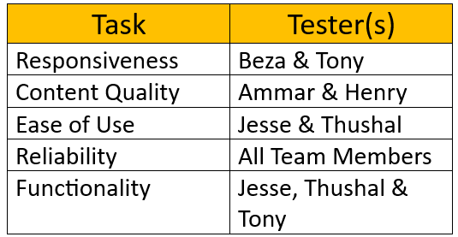
Task Allocation

Slide 12
Sources
Lehman, J. (2023). How to write a great software test plan. How to Write a Great Software Test Plan. Retrieved March 21, 2023, from https://microtoolsinc.com/papers/how-test-plan/
Lutkevich, B., & Lewis, S. (2022, November 14). What is the waterfall model? - definition and guide. Software Quality. Retrieved March 21, 2023, from https://www.techtarget.com/searchsoftwarequality/definition/waterfall-model
Rice, R. W. (2023). What is a test plan? The Complete Guide for writing a Software Test Plan. PractiTest. Retrieved March 21, 2023, from https://www.practitest.com/qa-learningcenter/best-practices/write-a-test-plan/
Tutorialspoint. (2023). Software testing - quick guide. Online Tutorials Library. Retrieved March 21, 2023, from http://www.tutorialspoint.com/software_testing/software_testing_quick_guide.htm

